Slide 1
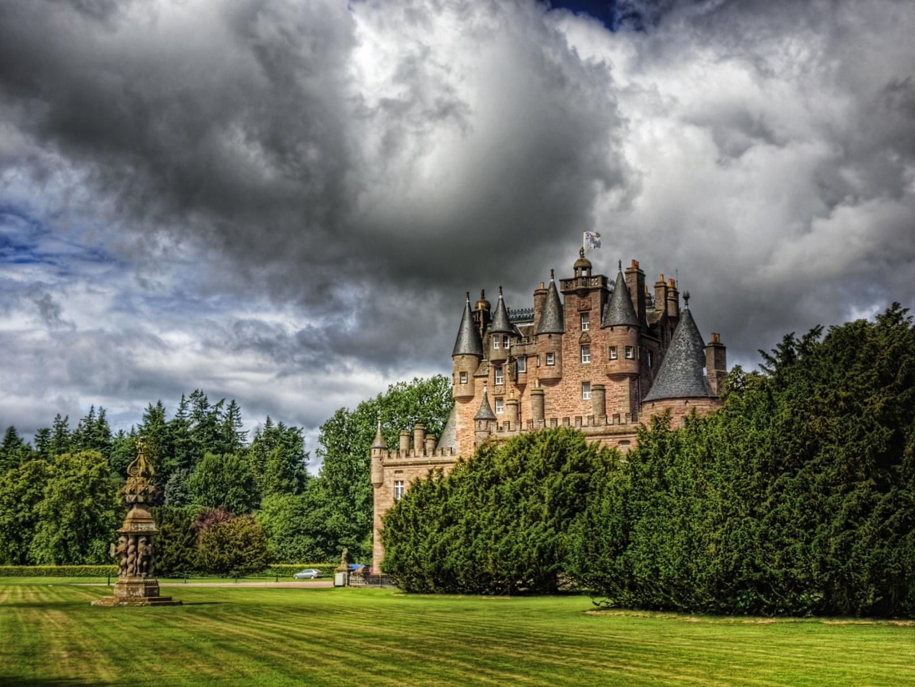
Glamis CastLE, SCOTLAND

Slide 2
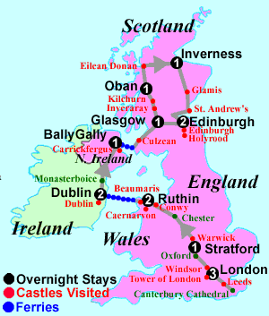

Slide 3
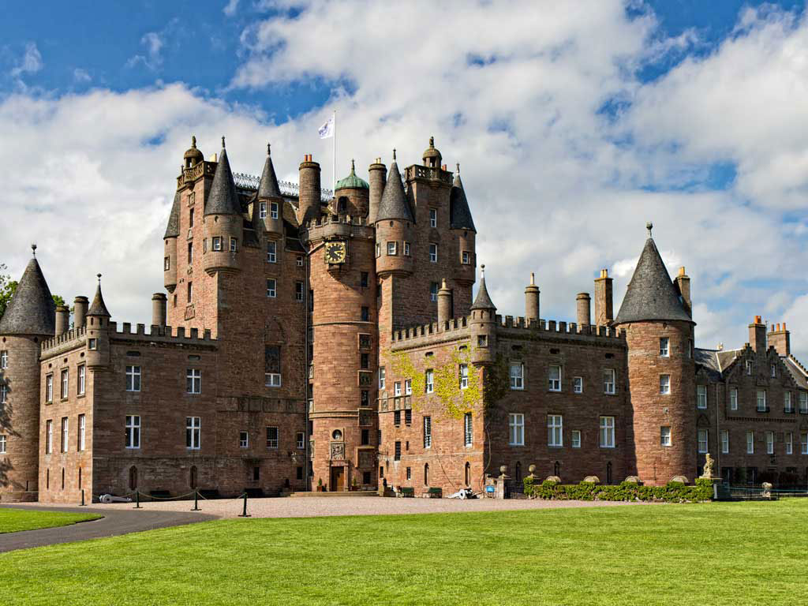
Castle exterior

Slide 4
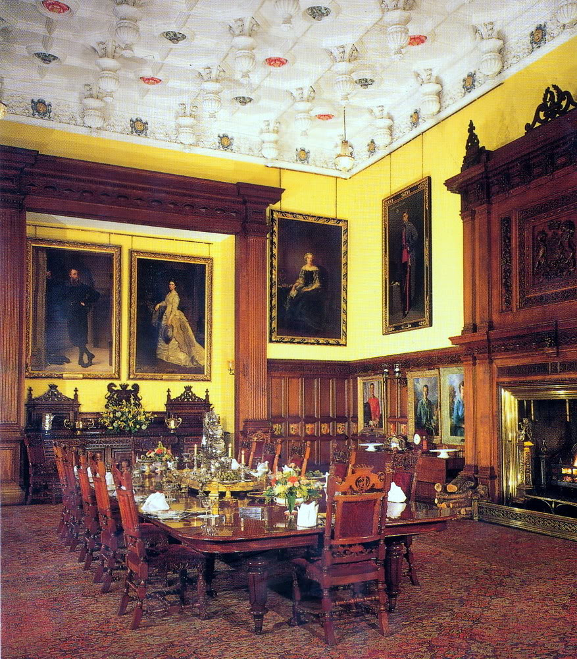
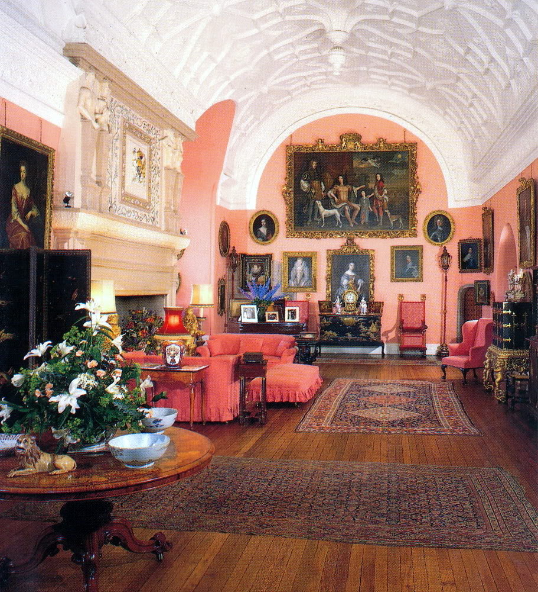
Drawing room
Dining room

Slide 5
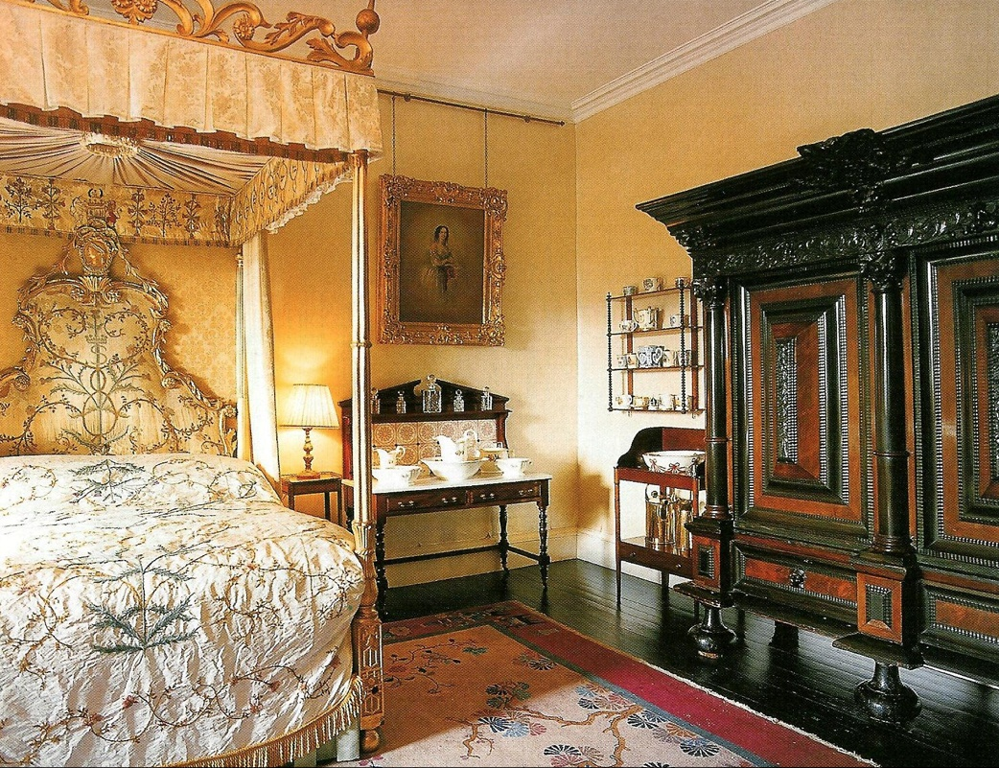
Bedroom

Slide 6
TOURISM
100km from Edingbourgh
No direct comfortable transport from distant cities except car (coach service available but tourists must change buses, rail yes but tourists need to take bus again)
Small hotels nearby- various categories
Tickets -adult 10.75 GBP- 12.65 EUR,
child 7.25 GBP-8.5 EUR
Over 100 000 visitors per year
Season: all year round, all ages - target group: adults
Events: Easter Day Out, Theatre Performances, Highland Games sports competitions
Website yes: 8 (no photo gallery, no event update)

Slide 7
STRENGTHS
Excellent historic place connected to present royal family
Outdoor and indoor attraction
Attractive all year round
Accommodation can be found nearby
Reasonable prices

Slide 8
WEAKNESSES
Lack of direct public transport
Far from major cities

Slide 9
ADVERTISING LANGUAGE
1. As soon as you see the Castle's turrets and towers nestled at the end of the mile-long drive, you can't fail to be impressed by its majesty.
(Turret- a small tower)

Slide 10
ADVERTISING LANGUAGE
.
2. Every little detail along the way is a sharp reminder that this is not a museum but an incredible family home that has witnessed everything from Royal births to being the setting for Shakespeare's Macbeth.
3. Its tales and secrets are brought to life by your own enthusiastic and knowledgeable tour guides.

